Slide 1


Planting Agent Technical Report
Autonomous Multiagent Systems
Course id :AI314
Instructor : Dr. Mohamed A. Wahby
Name - ID
Ahmed Kadry 20180018
Loai Gamal 20180206
Mohamed Sayed 20180224
Marina Moheb 20180208
8 June - Spring 2021

Slide 2
Robot's abilities
Robot's abilities
Detect if the soil suitable to be sowed by checking soil moisture and soil acidity.
Check the factors responsible for planting like temperature and light
Tells us to start planting or to fix any of the factors first.
Dig the soil then drag the seed into it.
Move a fixed distance to put another seed
Robot will use its senosrs to move the distance automatically.

Slide 3
Other Versions
Other Versions
Thorvald :It is an autonomous modular robot that can be configured for mostagricultural environments. It can operate in open fields, tunnels, orchardsand greenhouses and perform tasks such as light treatment for diseasemanagement, picking fruits and vegetables, phenotyping, in-fieldtransportation, cutting grass for forage production, spraying and datacollection/crop prediction.Thorvald operates entirely on its own, using advanced navigation methodsand artificial intelligence to perform a wide variety of tasks. The robot issmall and lightweight, allowing it to perform many tasks on a farm moreeffectively and for less cost than by using tractors or manual labourers.

Slide 4
Rationality
The robot is rational
Performance measuring success
Agent prior knowledge of environment
Actions that agent can perform
Agent percept sequence of data

Slide 5
Planning
what is our problem?
what is our main goal?
What is up coming?
the problem is in sowing the seeds.
model that sows seeds
we have global requirement in this model is to design a robot that picks and drops seeds on the soil.
Secondary requirements is :
To sense the presence of soil and Divide it into squares.
To make a hole at center of each square.
To pick seeds from the seed-container and drop it in the hole.
To develop a program to achieve and control all of these.

Slide 6
Analysis
what is the inputs?
what is the outputs?
Ultrasonic sensor
Soil moisture sensor
pH sensors
Changing light conditions
Temperature sensor
Data from input sensors

Slide 7
PEAS
Performance Measure:
Improved efficiency in planting.
Increased yielding and reliability in crop.
Increased cropping frequency.
Increased speed of seed planting.
Seed planting accuracy.
Durable and cheap as low-cost materials are used.
Less maintenance cost.
Since seed can be poured at any required depth, the plant germination is improved.
Dependency on labor also decreased. Also, it saves time of sowing.
Uniform placement of seeds in row with required distance.
Proper compaction over the seeds is provided

Slide 8
PEAS
Environment:
Farmer
Seeds
Fertile agricultural land
Temperature
Sun

Slide 9
PEAS
Actuators
Structural frame
Battery powered wheels
Seed storage tank
Seed sowing disc
Seed chamber
Plough

Slide 10
PEAS
Sensors
Ultrasonic sensor
Soil moisture sensor
pH sensors
Changing light conditions
Temperature sensor

Slide 11
Environment type
Fully observable
Deterministic certainty
Episodic
Dynamic
Discrete
Single agent

Slide 12
Agent type
What it’s type?
It is goal based agent

Slide 13
Formulate the problem precisely
what is our problem?
what is our problem type of formulation ?
the problem is in sowing the seeds.
incremental formulation

Slide 14
Formulate the problem precisely
Formulation:
States
Initial states
Actions
Transition states
Goal test
Position of the robot.
Bucket of the seeds is empty or not.
The soil seeded or not.
Start of line.
Bucket of seeds is not empty.
The soil not seeded.
Move forward on the line.
Fill the bucket of the seeds if it empty.
Dig the soil to make it okay for seeding.
Seeded the soil by the seeds.
When it complete seeding in the soil on the hole line.
End of the line.
Bucket of seeds is not empty.
The soil is seeded.

Slide 15
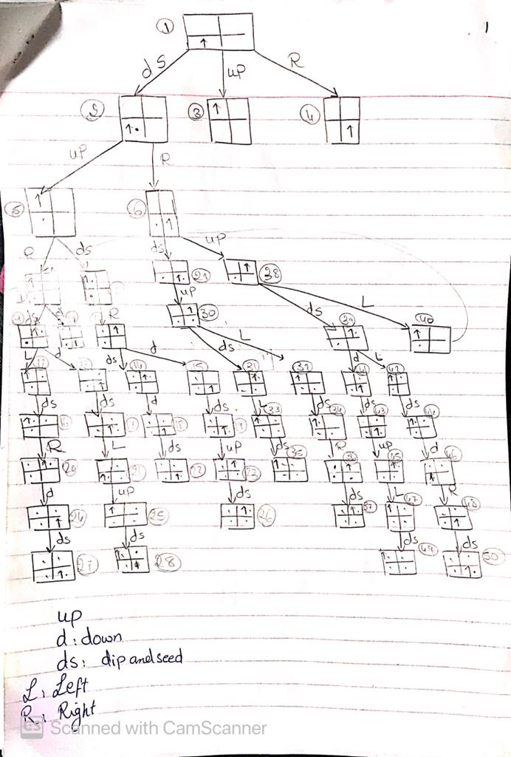
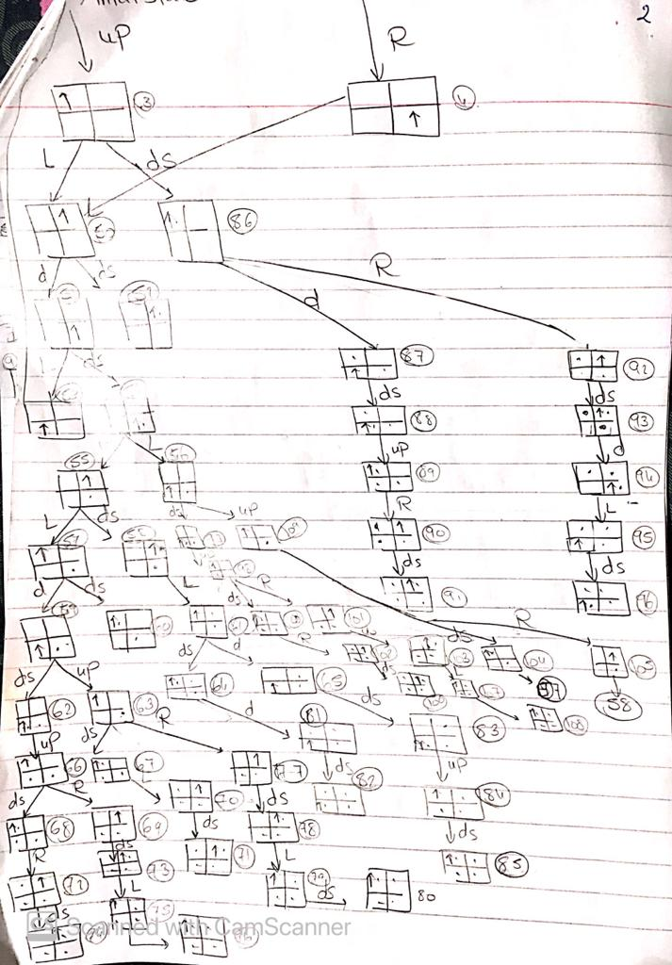
Diagram of the complete state space

Slide 16
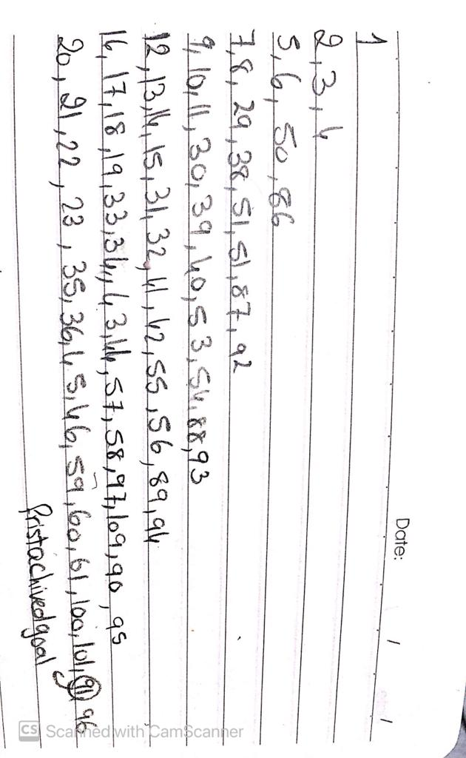
The problem using two different search algorithms
1- BFS
Number of iterations: 67
Time complexity: O(Time unit * number of iterations=67)
Space complexity : O(7* nodes in each level)
The states searched:

Slide 17
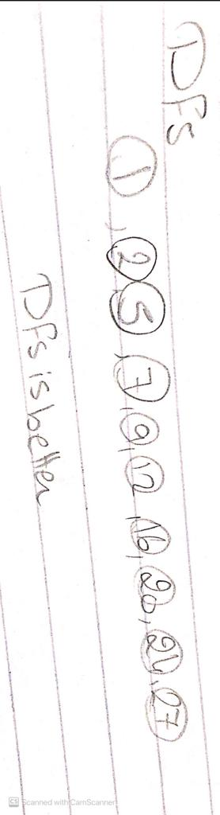
The problem using two different search algorithms
2- DFS
Number of iterations: 10
Time complexity : O (time unit * number of iterations=10)
Space complexity: O(10) # the maximum height of the tree
States searched :

Slide 18
Best algorithm
The best algorithm in our case is the DFS.
Less number of iterations
Less time complexity
Less space complexity
* as there is multiple optimal solutions so it will find the optimal solution from the very left branch which is the first branch it will searc,

Slide 19
Code to find the solution
Class Node
Contain inside two class : Node and State
This class have responsibility for initialize each state and its actions & parent
Class state have responsibility for position of state

Slide 20
Code to find the solution
Stackfrontier
This class is for searching in the stack
Have remove function for removing last node from stack and and keep it

Slide 21
Code to find the solution
Class Robot
To take position of the robot as k-input .
Get action function to get all probably actions on each state and check what state we will go from this action.

Slide 22
Code to find the solution
Class solve
This class is to implementation the concept of Dfs algorithm on each state

Slide 23
Code to find the solution
Class draw
To map and draw the output of the program

